Slide 1
FRACTURE
SR. Kiranjot gill
(Nursing superintendent)

Slide 2
DEFINITION
A fracture is a disruption or break in the continuity of bone.
Bone fractures are often caused by falls, injury or direct hit to the body

Slide 3
CLASSIFICATION
There are 4 main categories of fracture-
Open fracture – the skin is broken and bone exposed, causing soft tissue injury
Closed fracture - the skin remains intact
Complete fracture – the break goes completely through the bone, separating it in two.
Incomplete fracture – the break goes partly through the bone, shaft is still intact.
Displaced fracture – the two ends of the broken bone are the separated from one another and out of their normal position.
Non-displaced fracture – the periosteum is intact across the fracture and the bone fragments are still in alignment.

Slide 4
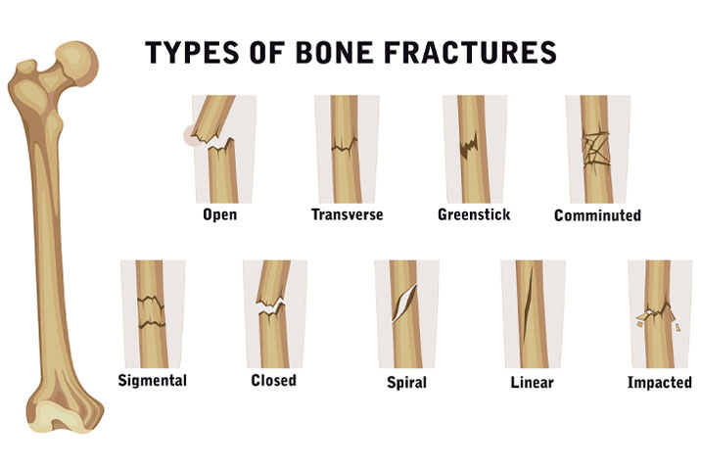

Slide 5
CLINICAL MANIFESTATION
Pain
Swelling
Bruising
Discoloured skin around the affected area
Protrusion of the affected area at an unusual angle
Inability to put weight on the injured area
Inability to move the affected area
A grating sensation in the affected bone or joint
Bleeding if it is an open fracture
In more severe cases, a person may experience:
Diziness
Fainting
Nausea

Slide 6
FRACTURE HEALING PROCESS
Definition-
A fracture is a breach in the structural continuity of the bone cortex, with a degree of injury to the surrounding soft tissues. Following the fracture, secondary healing begins, which consists of four steps:
Hematoma formation
Fibrocartilaginous callus formation
Bony callus formation
Bone remodelling

Slide 7
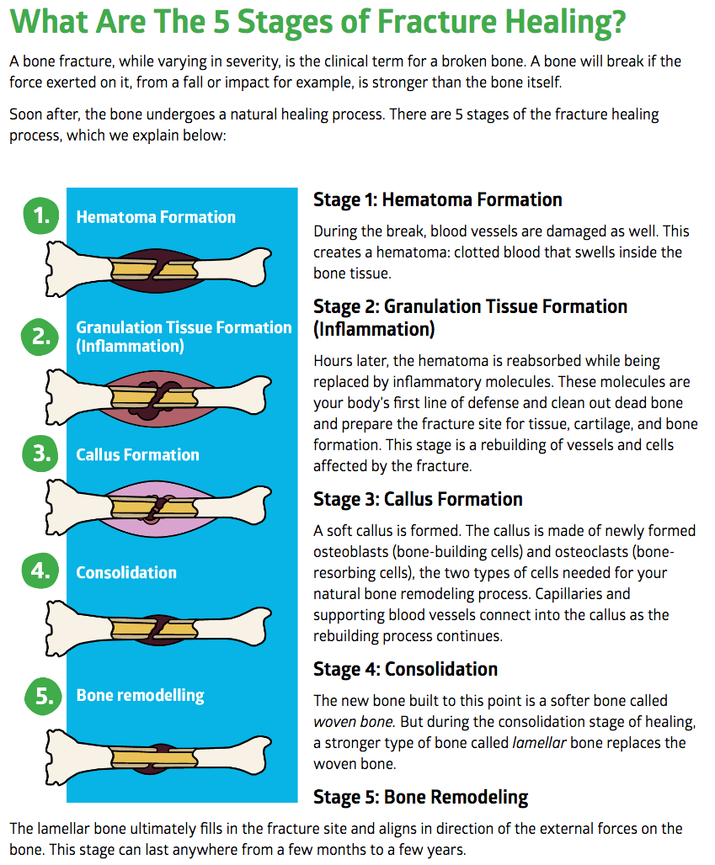

Slide 8
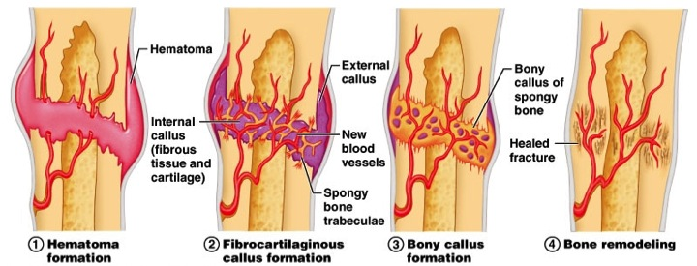

Slide 9
FACTORS INFLUENCE THE FRACTURE HEALING
Displacement and site of the fracture.
Blood supply to the area.
Immobilisation and use of internal fixation device.
The ossification may stopped due to inadequate reduction, immobilisation, excessive movement of fracture fragment, infection, poor nutrition and systematic disease(DM).
Age.
Smoking

Slide 10
COMPLICATIONS OF FRACTURE HEALING
Bone infections (osteomyelitis). Infections can occur when bacteria enter the body during a trauma. Less commonly, infections can happen during surgery to set a bone.
Bone deformities (malunions). Bones that are misaligned can heal in abnormal positions and cause malunions.
Delayed union and nonunion fractures. A fracture that takes longer to heal than usual is called a delayed union. A nonunion fracture is one that fails to heal.
Angulation- fracture heals in abnormal position in relation to midline of structure.
Pseudoarthrosis- type of nonunion occuring at fracture site in which a false joint is formed with abnormal movement.
Refracture - new fracture occurs at original fracture site.
Myositis ossification – deposition of calcium in muscle tissue at site of significant blunt muscle trauma or repeated muscle injury.

Slide 11
INTERPROFESSIONAL CARE
Anamatic realignment of bone fragments through reduction.
Immobilisation to maintain realignment.
Restoration of normal or near-normal function of the injured part.

Slide 12
FRACTURE REDUCTION
Closed reduction of a fractured bone
Closed reduction is a nonsurgical, manual realignment of bone fragments to their previous anatomical position.
Done under local or general anaesthesia.
Traction, casting, splints or orthoses may be used after reduction to maintain alignment and immobilize the injured part until healing.
Closed reduction of a fractured bone
Open reduction is the correction of bone alignment through surgical incision.
It includes internal fixation of the fractures with wires, screws, pins, intramedullary rods, or nails.

Slide 13
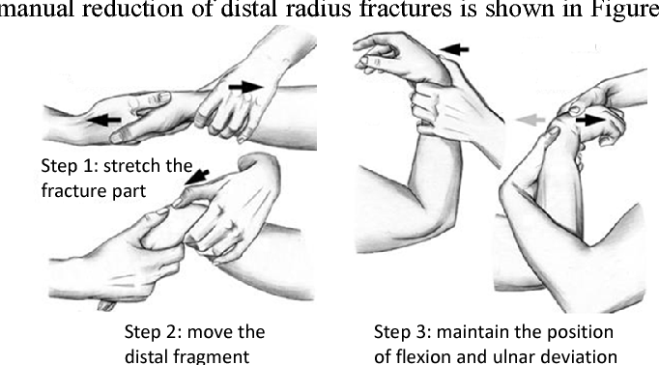

Slide 14
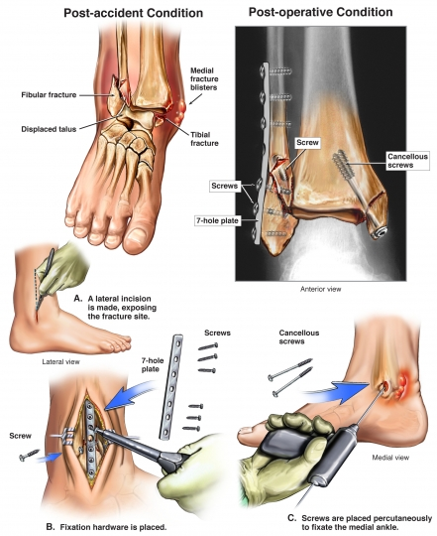

Slide 15
TRACTION
Traction refers to the practice of slowly and gently pulling on a fractured or dislocated body part. It’s often done using ropes, pulleys, and weights. These tools help apply force to the tissues surrounding the damaged area.
The purpose of traction is to guide the body part back into place and hold it steady. Traction may be used to:
stabilize and realign bone fractures, such as a broken arm or leg
help reduce the pain of a fracture before surgery
treat bone deformities caused by certain conditions, such as scoliosis
correct stiff and constricted muscles, joints, tendons, or skin
stretch the neck and prevent painful muscle spasms

Slide 16
What Are the Different Types of Traction?
The two main types of traction are skeletal traction and skin traction. The type of traction used will depend on the location and the nature of the problem.
Skeletal Traction
Skeletal traction involves placing a pin, wire, or screw in the fractured bone. After one of these devices has been inserted, weights are attached to it so the bone can be pulled into the correct position. This type of surgery may be done using a general, spinal, or local anesthetic to keep you from feeling pain during the procedure.
The amount of time needed to perform skeletal traction will depend on whether it’s a preparation for a more definitive procedure or the only surgery that’ll be done to allow the bone to heal.
Skeletal traction is most commonly used to treat fractures of the femur, or thighbone. It’s also the preferred method when greater force needs to be applied to the affected area. The force is directly applied to the bone, which means more weight can be added with less risk of damaging the surrounding soft tissues.

Slide 17
Skin Traction
Skin traction is far less invasive than skeletal traction. It involves applying splints, bandages, or adhesive tapes to the skin directly below the fracture. Once the material has been applied, weights are fastened to it. The affected body part is then pulled into the right position using a pulley system attached to the hospital bed.
Skin traction is used when the soft tissues, such as the muscles and tendons, need to be repaired. Less force is applied during skin traction to avoid irritating or damaging the skin and other soft tissues. Skin traction is rarely the only treatment needed. Instead, it’s usually used as a temporary way to stabilize a broken bone until the definitive surgery is performed.

Slide 18
CERVICAL TRACTION
During cervical traction, a metal brace is placed around your neck. The brace is then attached to a body harness or weights, which are used to help correct the affected area. Cervical traction is performed using a general anesthetic, so you’ll be asleep throughout the entire procedure.
Cervical traction might be used in two different situations. First, it may be done to gently stretch the neck muscles so muscle spasms can be relieved or prevented. It may also be performed to immobilize the spine after a neck injury.

Slide 19
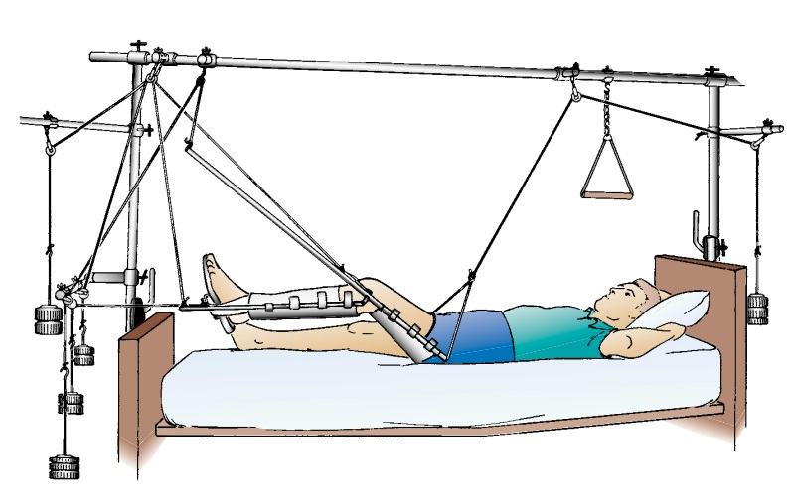

Slide 20
What Are the Risks of Traction?
There are risks involved in all surgical procedures. These risks include:
an adverse reaction to the anesthesia
excessive bleeding
an infection of the pin site
damage to the surrounding tissue
nerve injury or vascular injury from too much weight being applied
It’s important to contact your doctor if:
the prescribed medications aren’t relieving your pain
the skin around the pin site becomes red, hot, or swollen
there’s drainage

Slide 21
FRACTURE IMMOBILISATION
Immobilization refers to the process of holding a joint or bone in place with a splint, cast, or brace. This is done to prevent an injured area from moving while it heals.
Purpose
Splints, casts, and braces support and protect broken bones, dislocated joints, and injured soft tissues such as tendons and ligaments. Immobilization restricts motion to allow the injured area to heal. It can help reduce pain , swelling, and muscle spasms . In some cases, splints and casts are applied after surgical procedures that repair bones, tendons, or ligaments. This allows for protection and proper alignment early in the healing process.

Slide 22
AIM OF IMMBILISATION
Decrease pain
Prevention of secondary injury
Transportation
Prevention of complication

Slide 23
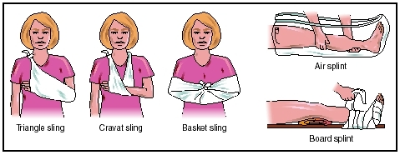

Slide 24
OPEN REDUCTION AND INTERNAL FIXATION
Open Reduction and Internal Fixation (ORIF) is a surgical procedure used to realign and stabilize broken bones. It involves making an incision to access the fracture site, manually repositioning the bone fragments (open reduction), and then using metal implants like plates, screws, wires, or rods to hold the bone fragments in place while they heal

Slide 25
EMERGENCY MANAGEMENT
Emergency management of a fracture focuses on stabilizing the injury, controlling bleeding, and seeking immediate medical attention. Key steps include immobilizing the fractured area with a splint or sling, applying ice to reduce swelling, and controlling any bleeding with direct pressure. Importantly, avoid moving the injured person unnecessarily and seek professional medical help as soon as possible

Slide 26
NURSING ASSESSMENT
Nursing management of a fracture focuses on preventing complications, promoting healing, and restoring function. Key aspects include pain management, fracture immobilization, infection prevention, and patient education on activity restrictions and rehabilitation. The nurse also assesses for and manages potential complications like neurovascular compromise, compartment syndrome, and fat embolism syndrome

Slide 27
NURSING DIAGNOSES
Acute pain, impaired physical mobility,
Risk for infection (especially in open fractures).
Knowledge deficit regarding fracture management.
Impaired mobility related to disease process.
These diagnoses are based on assessments of pain levels, mobility limitations, potential for infection, and the patient's understanding of their condition.

Slide 28
AMBULATORY CARE
Ambulatory care for fractures focuses on managing fractures in a way that allows patients to be discharged home and continue treatment as outpatients, rather than requiring extended hospital stays. This approach, often used for distal radius fractures and other less severe fractures, aims to reduce hospital stays and promote faster recovery.

Slide 29
COMPLICATIONS OF FRACTURE
Fractures can lead to various complications, including both early and delayed issues. Early complications include infection, compartment syndrome, deep vein thrombosis (DVT), and nerve or blood vessel damage. Delayed complications can involve
delayed union, nonunion, malunion, avascular necrosis, and heterotopic ossification.
Additionally, fractures can cause fat embolism syndrome, pulmonary embolism, and osteomyelitis.

Slide 30


