Slide 1
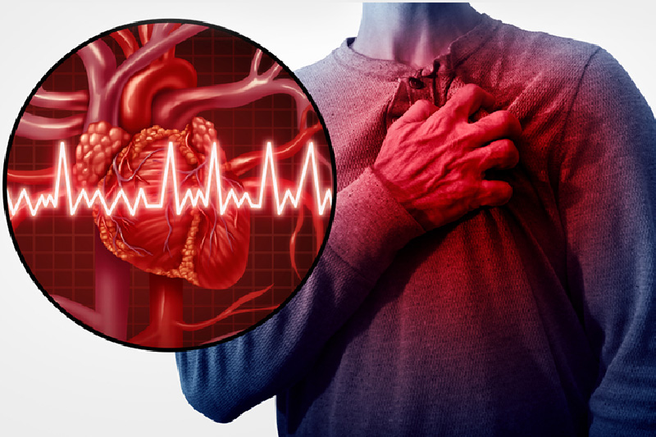
Myocardial infarction
SR. Kiranjot gill NURSING SUPERINTENDENT

Slide 2
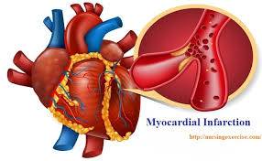
DEFINITION OF MI
Myocardial infarction (MI) refers to tissue death (infarction) of the heart muscle (myocardium) caused by ischaemia, that is lack of oxygen delivery to myocardial tissue.
It is a type of acute coronary syndrome, which describes a sudden or short-term change in symptoms related to blood flow to the heart.

Slide 3
ETIOLOGY
Tobacco smoking ➢Hypertension ➢Drug abuse ➢ Obesity ➢Stress ➢ Alcohol ETIOLOGY
7. ➢Age ➢Gender ➢ Diabetes ➢ Hyperlipoproteinaemia ➢ Family history of Ischaemic Heart Disease ➢ Hyperhomocysteinemia ➢ Chronic kidney disease

Slide 4
PATHOPHYSIOLOGY Atherosclerosis Arterial spasm Atherosclerosis+Plaque split+Thrombus gradual sudden not usually reversible Obstruction sudden reversible occlusion obstruction ISCHAEMIA Hypoxia Reduced oxygen demand Angina Thrombolysis Unstable angina Permanent thrombus Necrosis MYOCARDIAL INFARCTION

Slide 5
CLINICAL MANIFESTATIONS: • Chest pain / chest discomfort • Dyspnea • Fatigue • Other symptoms include: Increased sweating Weakness Nausea Vomiting Light-headedness Palpitation • Anxiety, sleeplessness, hypertension or hypotension, arrhythmia. • Chest pain is less in women, their common symptoms are weakness, fatigue & dyspnea.

Slide 6
Complications include: ➢ Arrhythmia ➢ Cardiogenic shock (10%) ➢ Congestive heart failure ➢ Thromboembolism ➢ Rupture (5%) ➢ Cardiac aneurism (5%) ➢ Pericarditis

Slide 7
CLINICAL MANIFESTATIONS: • Chest pain / chest discomfort • Dyspnea • Fatigue • Other symptoms include: Increased sweating Weakness Nausea Vomiting Light-headedness Palpitation • Anxiety, sleeplessness, hypertension or hypotension, arrhythmia. • Chest pain is less in women, their common symptoms are weakness, fatigue & dyspnea.

Slide 8
DIAGNOSIS:
1.Clinical features: ➢Pain ➢Indigestion ➢Apprehension ➢Shock ➢Low grade fever
2.Serum cardiac markers: ➢Creatinine phosphokinase (CK) ➢Lactic dehydrogenase (LDH) ➢Cardiac specific troponins (cTn)

Slide 9
3.ECG changes: ➢ ST segment elevation ➢ T wave inversion ➢ appearance of wide deep Q waves.
4.MAGNETIC RESONANCE IMAGING (MRI) ➢CHEST X- RAY ➢ANGIOGRAPHY ➢POSITRON EMISSION TOMOGRAPHY (PET scan):

Slide 10
3.ECG changes: ➢ ST segment elevation ➢ T wave inversion ➢ appearance of wide deep Q waves.
4.MAGNETIC RESONANCE IMAGING (MRI) ➢CHEST X- RAY ➢ANGIOGRAPHY ➢POSITRON EMISSION TOMOGRAPHY (PET scan):

Slide 11
PHARMACOLOGICAL: ✓Thrombolytic agents ✓Anticoagulants ✓Antiplatelet agents ✓Antihypertensive agents ✓Lipid lowering drugs ✓Vasodialators ✓Others i) Analgesics ii) Antiulcer drugs iii) Antidepressants

Slide 12
MEDICAL MANAGEMENT
TREATMENT ALGORITHM FOR MI: Myocardial Infarction Pre-hospital or on arrival GTN spray, Oxygen, Pain relief, Admission to hospital, Aspirin, Thrombolytics During hospital admission Add: beta blocker, ACE inhibitor, insulin Consider: Revascularization (Angioplasty, Stenting, Arterial bypass) Long term Rehabilitation classes: Aspirin, beta blocker, ACE inhibitor, Statins

Slide 13
INVASIVE PROCEDURE OF MI
Percutaneous transluminal coronary angioplasty (PTCA) stent placement
Atherectomy coronary artery bypass graft (CABG)

Slide 14
NURSING DIAGNOSIS OF MI
Acute Pain,
Decreased Cardiac Output,
Ineffective Tissue Perfusion,
Anxiety,
Risk for Decreased Cardiac Perfusion.
These diagnoses guide the development of a comprehensive care plan to address the patient's physical and emotional well-being

Slide 15
NURSING MANAGEMENT
Nursing management of Myocardial Infarction (MI), or heart attack, focuses on immediate stabilization,
symptom management, and
preventing complications, while also educating patients about lifestyle changes for long-term recovery.
Nurses play a crucial role in recognizing symptoms, administering medications, monitoring vital signs, and providing psychological support

Slide 16
COMPLICATIONS OF MI
Complications of myocardial infarction (MI), or heart attack, can arise from the initial damage to the heart muscle (ischemia) or from mechanical, electrical, or inflammatory disturbances that occur during or after the event. These complications can significantly impact a patient's recovery and long-term prognosis.

Slide 17


